Slide 1


SMART INDIA HACKATHON 2024
NAYI DISHA
Problem Statement ID: 1632
Problem Statement Title: An interactive job and internship platform for Technical Education Department, Govt. of Rajasthan.
Theme: Smart Education
PS Category: Software
Team ID:
Team Name: NAYI DISHA

Slide 2
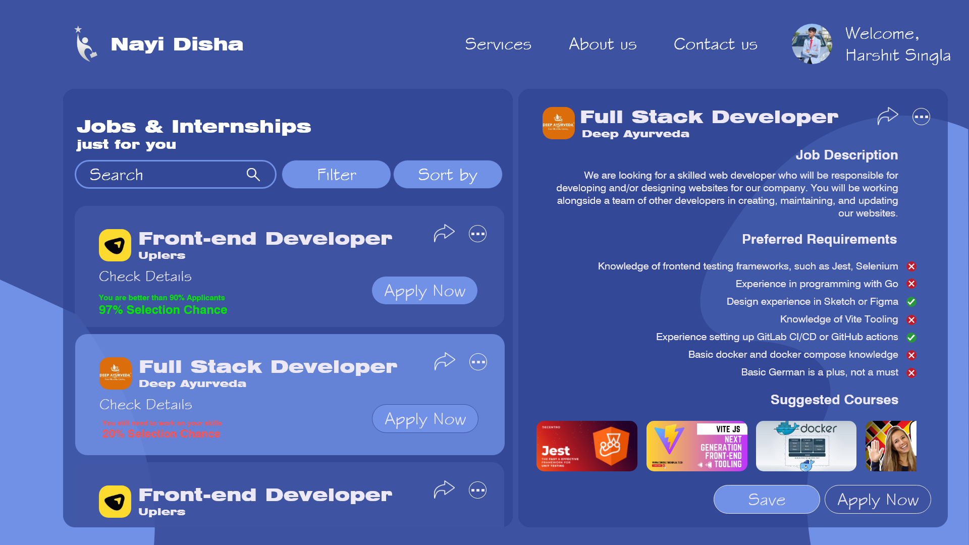
Career Guidance through Machine Learning
NAYI DISHA
Resume analysis
Evaluate job readiness
Tailored learning path

Slide 3













The Tech Behind Our Solution
NAYI DISHA
Machine Learning

Slide 4
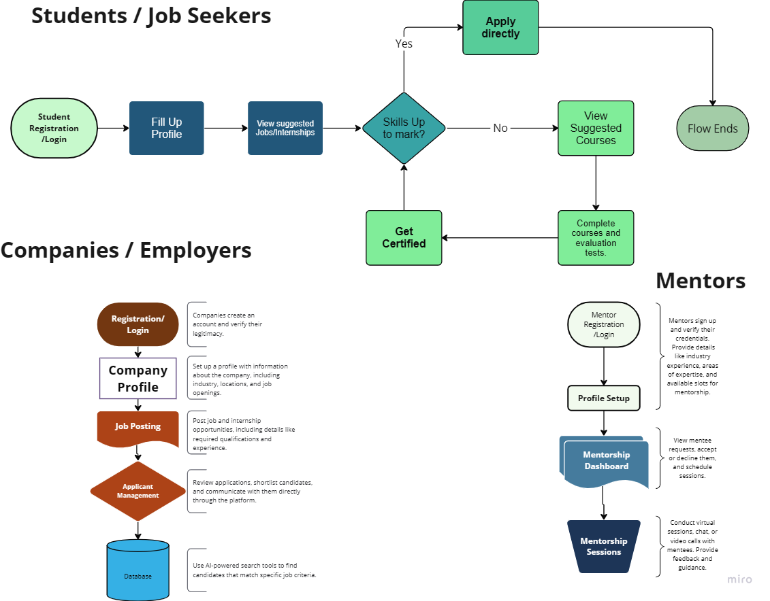
RESEARCH AND REFERENCES
NAYI DISHA
General resources:
World Bank: https://www.worldbank.org/en/home
International Labor Organisation: https://www.ilo.org/
Job boards:
Indeed: https://www.indeed.jobs/
Linkedin: https://www.linkedin.com/
Career counseling:
National Career Service: https://www.ncs.gov.in/
WorkFlow
For
different
users

Slide 5
Business Case for Career Compass
NAYI DISHA
Data acquisition
Partnership with educational institutions
User privacy
Clear data retention policy
Model deployment
Cloud platform
Online inference

Slide 6
Automated Readiness Analysis
NAYI DISHA
Detailed report generation to assess preparation levels.
Offers a valuable personal assessment tool

